Slide 1

Term Project
Husam Muthanna
Cis-476
Notes:
My name is Husam Muthanna, and this is my Term Project for CIS-476. Today, I’ll walk you through how I used several design patterns to build a My Driver peer to peer rental platform.

Slide 2
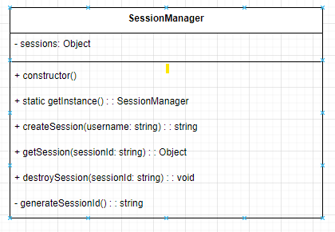
User Authentication and Encryption: Implement the Singleton pattern to manage the user's session securely. SessionManger.js
The project uses the Singleton Design Pattern in the SessionManager class. Here's how it integrates into the overall design
1. Singleton Design Pattern:
The SessionManager ensures that only one instance of the class exists throughout the application. This is achieved by checking if an instance already exists in the constructor and returning it if it does.
The getInstance static method provides a global access point to the single instance of the SessionManager.
2. Integration into the Overall Design:
The SessionManager is responsible for securely managing user sessions. By using the Singleton pattern, it ensures that session data is centralized and consistent across the application.
This design avoids the risk of multiple instances managing sessions independently, which could lead to data inconsistency or security issues.
It simplifies session management by providing a single point of control for creating, retrieving, and destroying sessions.
Notes:
Let’s start with User Authentication. Here, I used the Singleton Design Pattern in the SessionManager class. The Singleton ensures that only one instance of a user session exists throughout the app. This central management improves both security and consistency, preventing conflicting session data. The getInstance method gives us a global access point, which simplifies session control.

Slide 3
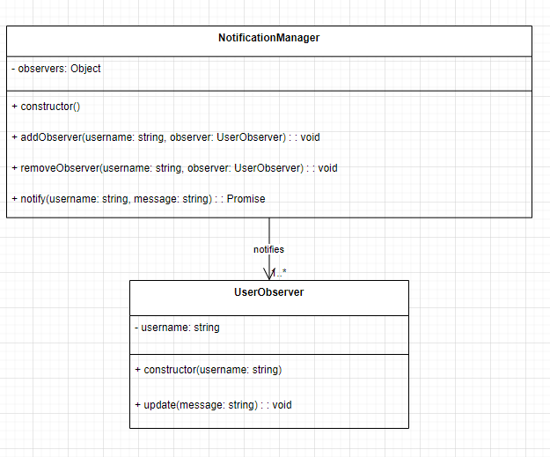
Observer Pattern for Booking Notifications: Apply the Observer pattern to notify users about important booking-related updates and changes and reviews NotificationManager.js
The project implements the Observer Design Pattern through the NotificationManager class. Here's how it fits into the overall architecture:
1. Observer Design Pattern
Subject: NotificationManager acts as the subject, maintaining a list of observers (users) for each username.
Observers: Instances of UserObserver register themselves with the NotificationManager to receive updates.
Notification Flow: When an event occurs, NotificationManager notifies all registered observers associated with the specific username.
2. Integration with Overall Design
Decoupled Logic: This pattern cleanly separates notification handling from other application logic, enabling modularity and easier maintenance.
Persistence: Notifications are also saved to the database (UserCollection), ensuring that users can access them even if they were not online or actively observing at the time.
Scalability: New types of observers can be introduced without modifying NotificationManager, supporting future extensibility.
This design supports real-time updates in a scalable, flexible, and maintainable way, making it ideal for user-centric features like notifications.
Notes:
Next, the Observer Pattern was implemented in NotificationManager. This handles booking updates and review notifications. Users register as observers, and when an event occurs, the system notifies all relevant users. It’s a great way to decouple the notification system from the core logic while ensuring real-time updates. Plus, all notifications are stored in the database so users don’t miss a thing—even if they’re offline.

Slide 4
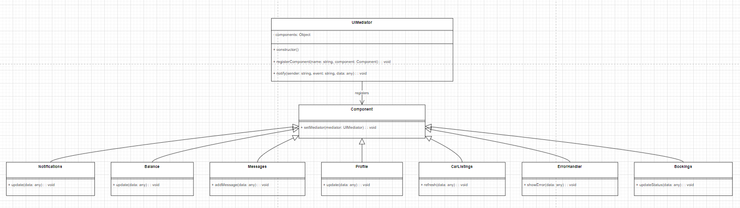
Mediator Pattern for UI Components: Implement the Mediator pattern to manage communication between different UI components, creating a cohesive and user-friendly interface. UIMediator.js
The project implements the Mediator Design Pattern through the UIMediator class. Here's how it contributes to the overall system architecture:
1. Mediator Design Pattern
Central Hub: UIMediator serves as a central hub that coordinates communication between UI components.
Indirect Communication: Components register with the mediator and interact through it, rather than directly with each other.
Event Routing: The notify method receives events from components and routes them to the appropriate target components.
2. Integration with the Overall Design
Decoupled Architecture: Components are decoupled from one another, depending only on the mediator. This improves modularity and maintainability.
Scalability: New components or events can be added easily, as changes are confined to the mediator logic without impacting other components.
Consistent UI Coordination: The UIMediator ensures smooth coordination of UI updates such as notifications, balance changes, messages, and error displays.
This design is especially effective for managing complex UI workflows in a scalable, organized, and maintainable manner.
Notes:
For managing UI interactions, I applied the Mediator Pattern in the UIMediator class. Instead of having components talk directly to each other, they communicate through the mediator. This approach leads to a much cleaner, decoupled architecture, making the UI modular and easier to maintain. It also helps route events efficiently—like displaying messages, balance changes, or errors.

Slide 5
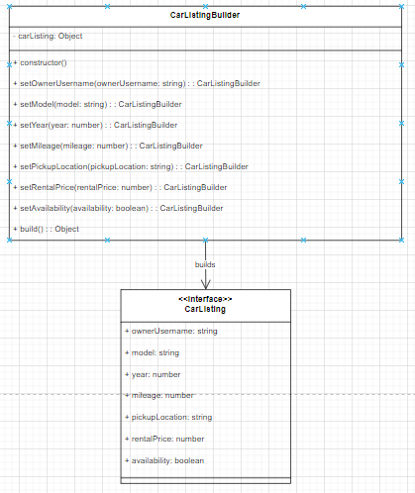
Builder Pattern for Car Listing Creation: Utilize the Builder pattern to create car listing objects with various attributes, allowing for flexibility in car listing creation and customization. CarListingBuilder.js
The project implements the Builder Design Pattern through the CarListingBuilder class. Here's how it fits into the overall system design:
1. Builder Design Pattern
Step-by-Step Construction: CarListingBuilder offers a structured way to create complex carListing objects one step at a time.
Readable and Flexible: Each method (e.g., setModel, setYear) sets a specific property, improving code readability and flexibility.
Finalization: The build method returns the fully constructed carListing object once all desired properties are set.
2. Integration with the Overall Design
Simplified Object Creation: Eliminates the need for bulky constructors by dividing the creation process into manageable steps.
Consistency and Safety: Ensures that all required fields are set, reducing the chance of incomplete or inconsistent listings.
Seamless Integration: Easily integrates with user interfaces and APIs by providing a clean, structured approach to dynamically build listings.
This pattern is especially effective for managing the creation of objects with multiple optional or required attributes, promoting clean, maintainable, and scalable code.
Notes:
Creating car listings is handled using the Builder Pattern with the CarListingBuilder class. This pattern is ideal when an object has multiple fields, some optional, some required. With methods like setModel or setYear, it allows flexible and readable object creation. The final build() method returns a complete listing, ensuring all important fields are correctly set.

Slide 6
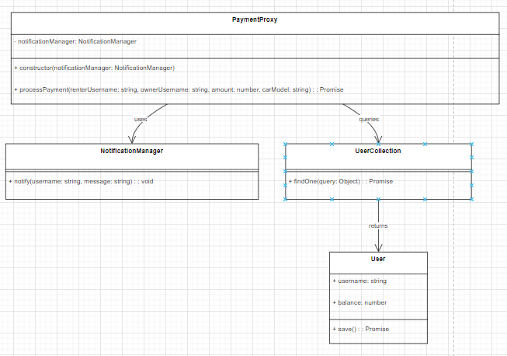
Proxy Pattern for Payment Integration: Implement the Proxy pattern to handle secure communication and transactions between the application and the payment system. PaymentProxy.js
The project uses the Proxy Design Pattern through the PaymentProxy class. Here's how it integrates into the overall system design:
1. Proxy Design Pattern
Intermediary Role: The PaymentProxy class serves as an intermediary between the application and the underlying payment processing logic.
Encapsulation: It encapsulates the payment process, ensuring essential checks (such as user existence and balance validation) are performed before the transaction is processed.
Notification Handling: After completing the payment, the proxy sends notifications to both the renter and the owner to confirm the transaction.
2. Integration with the Overall Design
Transaction Control: This pattern adds a layer of control to the payment process, ensuring security and consistency in handling transactions.
Modular Architecture: It decouples the payment logic from other parts of the system, making it more modular and easier to maintain.
User Experience: By integrating with NotificationManager, the proxy ensures users are informed of payment events, improving the overall user experience.
Sensitive Operations: The Proxy Pattern is particularly suited for managing sensitive operations like payments, where additional checks and controls are essential for ensuring security and correctness.
Notes:
For secure transactions, I used the Proxy Pattern in the PaymentProxy class. This acts as a gatekeeper between the app and the payment processor. It performs checks like user validation and balance sufficiency before allowing a transaction. After payment, it sends out notifications, enhancing both security and user experience. The proxy also makes the system modular, keeping sensitive payment logic separate.

Slide 7
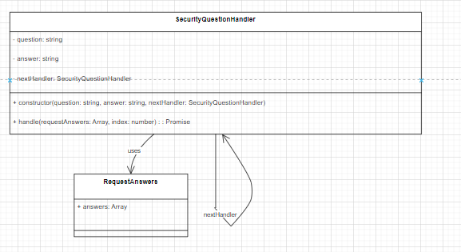
Chain of Responsibility for Password Recovery: Apply the Chain of Responsibility pattern to create a secure process (using three security questions to build the chain) for recovering a forgotten password. Index.js
The project uses the Chain of Responsibility Design Pattern through the SecurityQuestionHandler class. Here's how it fits into the overall system design:
1. Chain of Responsibility Design Pattern
Sequence of Handlers: The SecurityQuestionHandler class is designed to manage a sequence of security questions.
Validation Process: Each handler in the chain is responsible for validating one security question and its corresponding answer.
Delegation: If a handler successfully validates the answer, it delegates the request to the next handler in the chain. If any handler fails, the process stops immediately.
2. Integration with the Overall Design
Password Recovery: This pattern is used in the password recovery process to validate a user's answers to security questions, ensuring that only the correct sequence of answers allows access.
Modular and Flexible: Each handler is responsible for one question, making it easy to add or modify questions without affecting the rest of the validation process.
Security: The chain ensures that all security questions are validated in sequence, strengthening the security of the password recovery mechanism.
Sequential Validations: This pattern is particularly effective for scenarios where multiple checks or validations need to be performed in a specific order.
Notes:
Finally, I used the Chain of Responsibility Pattern in the password recovery feature. This involves a chain of SecurityQuestionHandler objects—each one responsible for one security question. Users must answer all questions correctly in sequence to reset their password. This pattern ensures a flexible and secure recovery process that’s easy to extend with new checks.

Slide 8
Functions/Features Completed
User Registration and Authentication:
Users can register on DriveShare using email and password authentication.
Include 3 security questions when registering.
Car Listing and Management:
Car owners can list their vehicles for short-term rental, providing details such as car model, year, mileage, availability calendar, pick up location and rental pricing.
Owners have the ability to manage their car listings, including updating availability and price
The system should prevent the same car from being rented by more than once at the same time.
Search and Booking:
Renters can search for available cars based on location, date, and other preferences.
Implement a booking system allowing renters to reserve a car for a specific period.
Messaging and Communication:
DriveShare includes a messaging system to facilitate communication between car owners and renters.
Send notifications for booking requests, confirmations, and important updates via email or in-app messages.
Payment:
Allow renters to make payment (A real payment is not required. A payment button with amount is enough, clicking on the button will change the balance and send notification to both owner and renter)
Notes:
Overall, I successfully implemented:
Secure user authentication
Real-time booking notifications
A modular UI interaction system
Flexible car listing creation
Safe and user-friendly payment processing
A secure password recovery flow All supported by powerful design patterns for scalability and maintainability.

